Slide 1
Questionary
We asked 20 people some questions about other countries, so here are the questions:

Slide 2
Where do you spend your holidays?
-5 out of 20 spend their holidays in Spain
-3 in France
-2 in Germany
-2 in England
-2 in Sweden
4 in Turkey
-And 2 in Northern Ireland

Slide 3
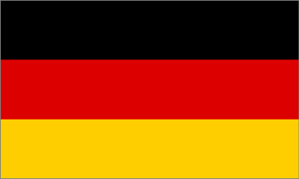
Do you know any of these languages?
All the people here in Poland know Polish, but do they know other languages?
Here are the answers of the people we asked.

Slide 4
What languages do people know? - 13 know English -4 know German -1 knows Spanish -2 Know French -and nobody knows Swedish or Turkish…

Slide 5
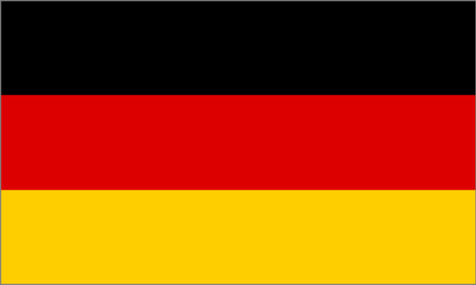
Do you have any family or friends in other countrys?
We asked 20 people and 16 people have family in other countrys, while 4 people don’t.

Slide 6
Where would you like to live?
A lot of Polish people live in other countrys, but where would they want to live?

Slide 7
Which one of these countries?
-2 out of 20 would like to live in Germany
-3 would like to live in Spain
-3 would like to live in France
-Only one would like to live in Turkey
-3 would like to live in England
3 would like to live in Northern Ireland
And 5 would like to live in Sweden

Slide 8
Why do you like these countries?
What do people like about these countries? Let’s find out.

Slide 9
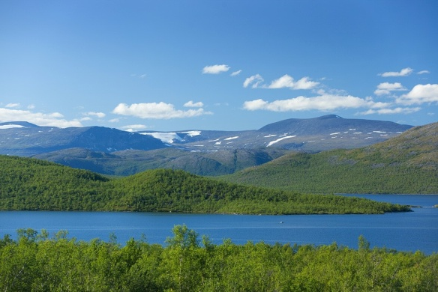
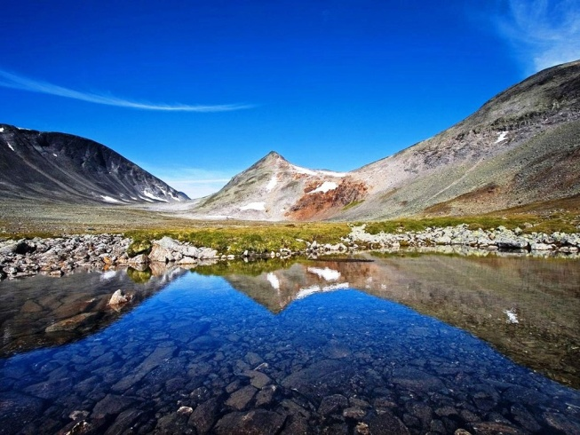
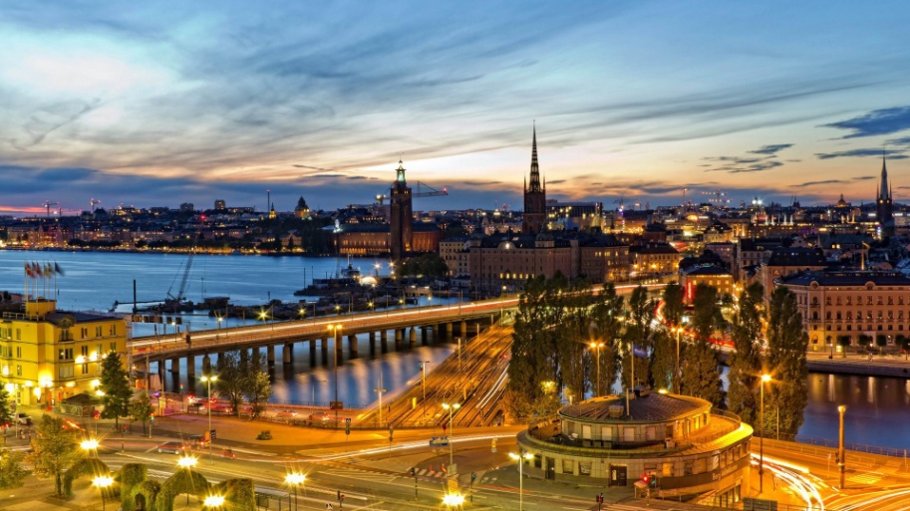
Sweden
People like the beautiful lakes and landscapes of Sweden, the fresh and clean air, the solid furniture and the food the most, but they also like Volvo cars, Ikea, the tourist attractions and beautiful Swedish women.

Slide 10
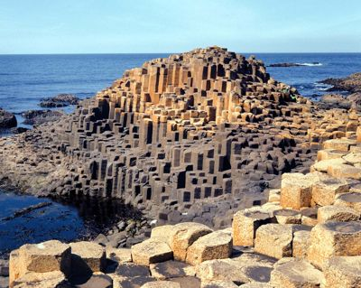
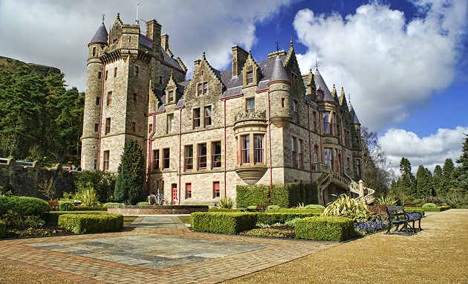
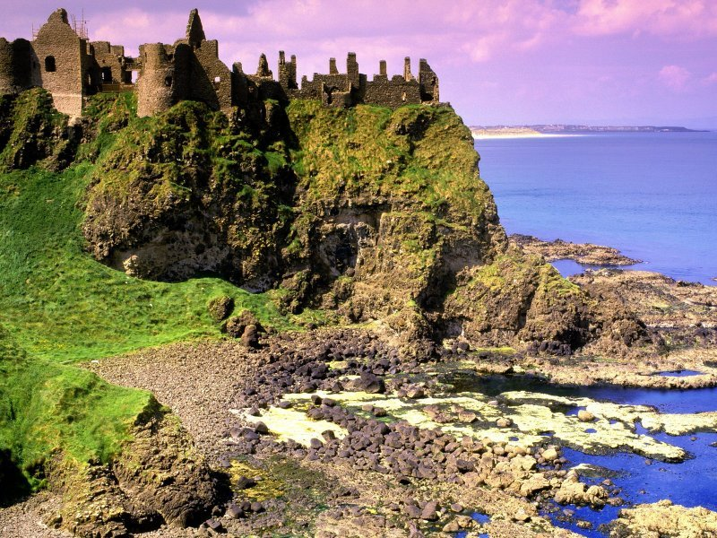
Northern Ireland
People say that Northern Ireland has the most beautiful Roadways in Europe, which is true, they also have strong family bonds, many fun pubs and restaurants, they also have an interesting culture and music, they are friendly and social.

Slide 11
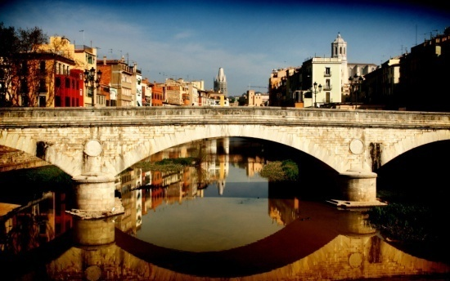
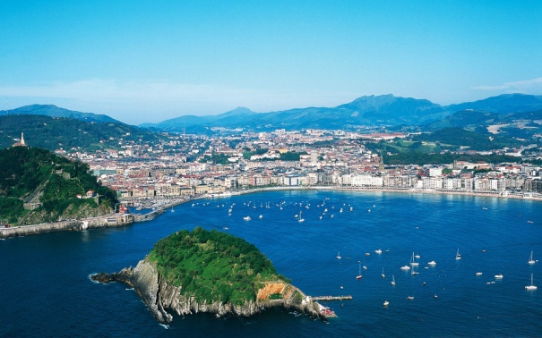
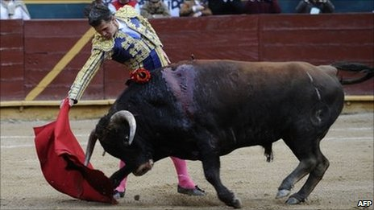
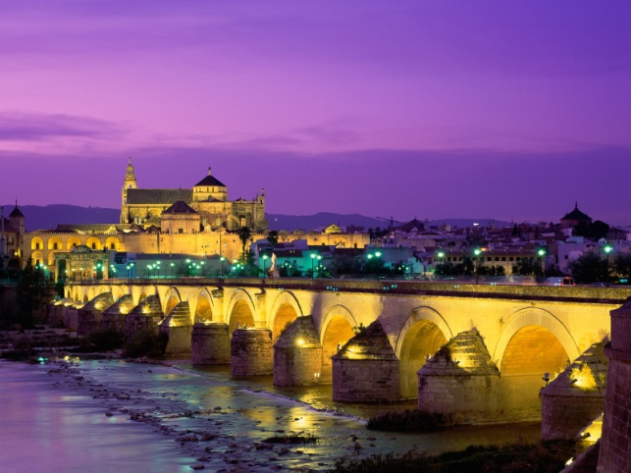
Spain
People like the many beaches and beautiful weather of Spain, Costa Brava, Lloret de Mar, the Spanish Sangria, the Corrida(Bull fighting), paella, they also like the Spanish language and the Flamenco dances.

Slide 12
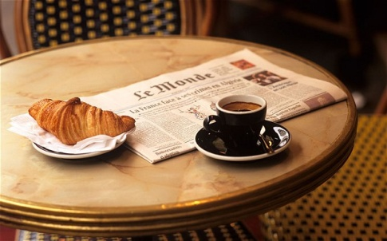
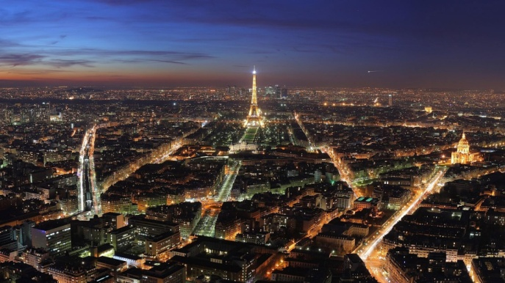
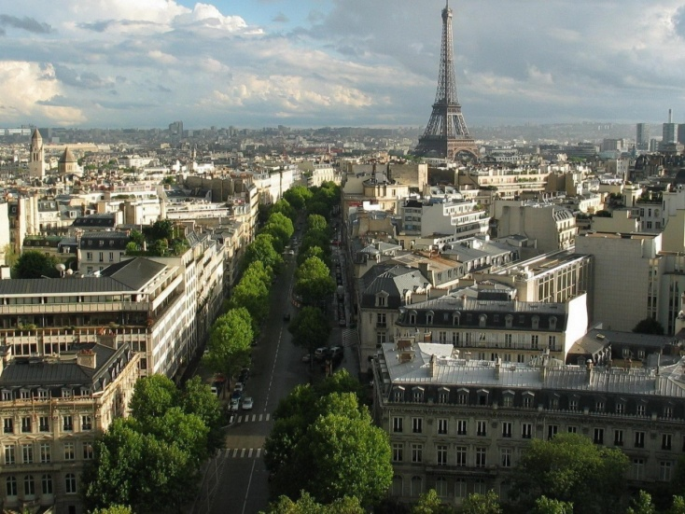
France
People love the French atmosphere, the Eiffel Tower, the delicious food and the friendly people, the famous French Wine, they also love the difficult yet beautiful language, Luwr, the stylish women, the Wersal and the many restaurants.

Slide 13
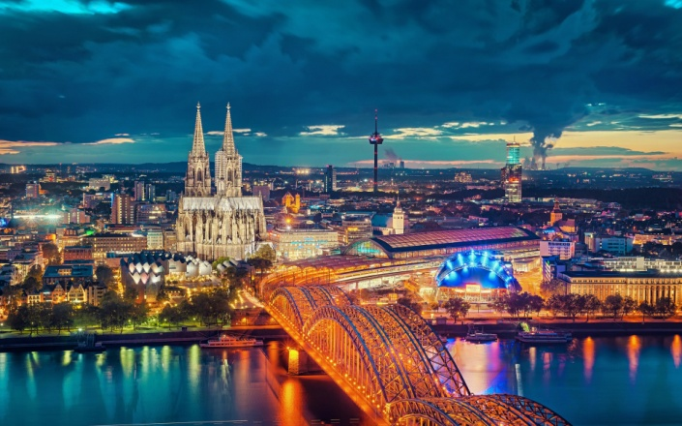
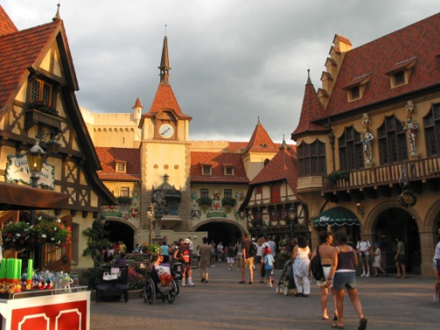
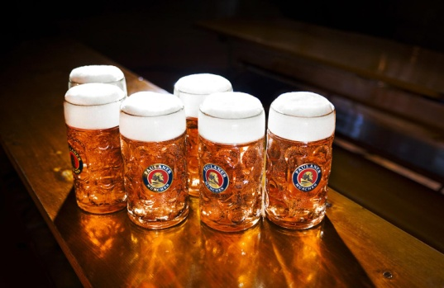
Germany
People like Germany because of the Oktoberfest, the Christmas Markets, Audi, Haribo, The BMW’s, Mercedes, and Opel. In Germany many tourists eat Bratkartoffeln or Currywurst and drink beer, the people are said to be very serious about keeping their country clean, but they can be kind and friendly too.

Slide 14
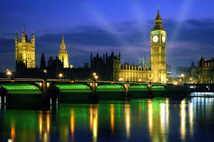
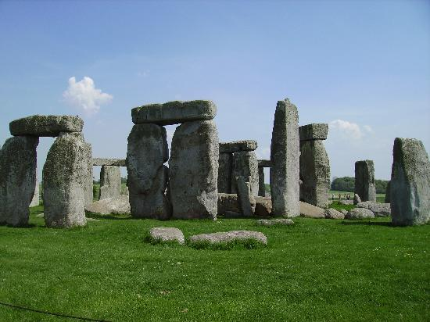
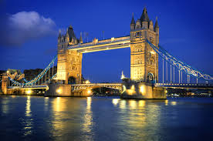
England
The people who have been asked said that England has the most famous and most beautiful language in the world, the most famous universitys(Carmbridge, Oxford), many tourist attractions, many people also like the tea time and the beautiful landscapes(not only England but Scotland, Wales and Ireland too)

Slide 15
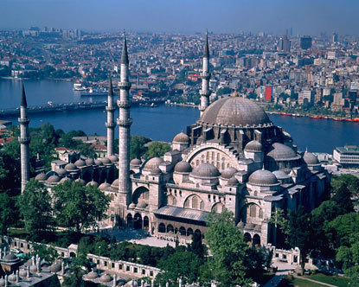
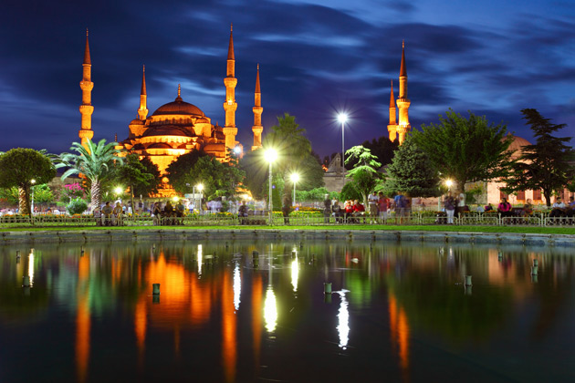
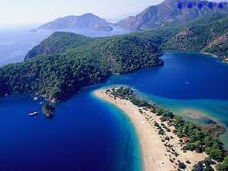
Turkey
The people we asked said that they loved the Turkish cooking, they also said that the Turkish are very kind and social. The tourists like staying there because of the fresh and clean air, the beautiful weather and the beaches, the colorful landscapes, the exotic fruit and sweets. This is what makes Turkey a very nice place that people like to visit.

